Slide 1
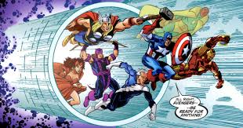

Heroes Assemble
CSCI 426 – Information Retrieval
- By Nadia Hossain, Nuran Ghoneim, Riddhi Makwana, Shipra Priyadarshini
- Prof. Houwei Cao

Slide 2

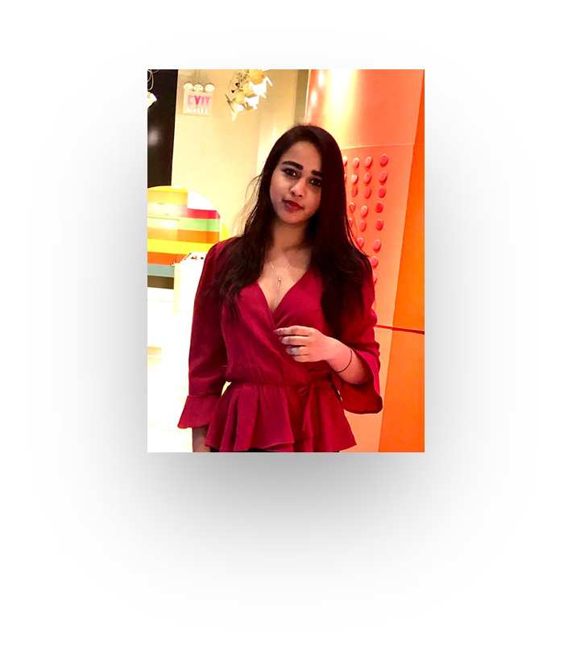


Meet Our Designers
Nadia
Nuran
Riddhi
Shipra
Front-End + Quiz
Database + Report
Front-End + Backend
Backend + Presentation

Slide 3
- Nuran
Purpose
Each universe has its own website with their own characters
Exposure to heroes that aren’t as popular
One platform
Notes:
the superheroes are all separated based by publisher, so you have to visit each site independently
The two main franchises are DC and Marvel, so some people may not know about other heroes by publishers like Dark Horse
we decided to combine all the heroes regardless of publisher onto one platform, so users have easy access to all the characters

Slide 4
- Nuran
Motivation
01
There’s a massive fanbase dedicated to superheroes who might appreciate
having access to all the characters in one place
02
It’s a great introduction for those who don’t know much about superheroes
Notes:
Instead of going to different websites to look up characters, now fans have the option of having everything in one place which is much more convenient
There’s also people who know nothing about superheroes at all. If they wanted to start learning about this world, they could be overwhelmed with the amount of information there is. This is a great way for them to get introduced to these characters since they’re all on one platform.

Slide 5




- Nuran
Existing Applications
DC Comics
Marvel
Superhero DB
Comic Vine
Notes:
DC Comics and Marvel have their own websites, including characters, movies, tv shows, merchandise and more
Superhero Database has all superheroes listed out along with their powers, history and more. However, this is more of a statistical website, it doesn’t provide images of the characters or their backstories. Their history section for the characters are empty
Comic Vine is a website created by a fan but it mainly has just DC and Marvel characters and we want to include all the superheroes

Slide 6
Table Schema
- Nadia
Appearance
Biography
SuperHeroId
Gender
Race
Height
Weight
EyeColor
HairColor
SuperHeroId
FullName
AlterEgoes
Aliases
PlaceOfBirth
FirstAppearance
Publisher
- Alignment
Connections
Power stats
SuperHeroId
GroupAffiliation
Relatives
SuperHeroId
Intelligence
Strength
Speed
Durability
Power
Combat
Superhero
Work
SuperHeroId
Name
Image
SuperHeroId
Occupation
Base
Database : 6 Tables

Slide 7
- Nadia
Data Collection
API
https://superheroapi.com/
Authentication
Facebook Log In
Data in form of JSON files

Slide 8
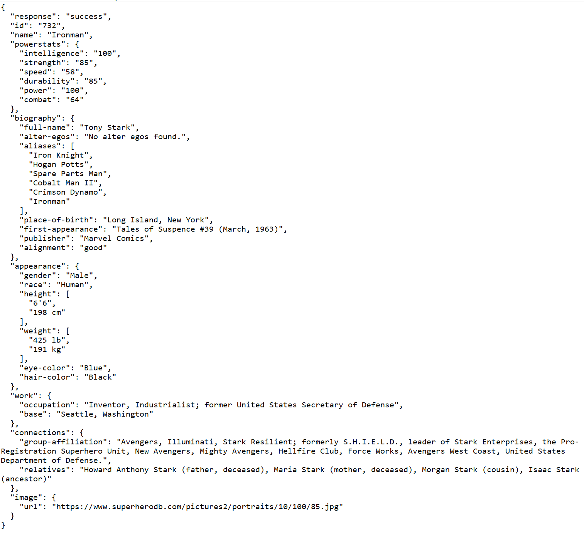
Dataset Example
- Nadia
← Sample Response Received for Iron Man
SuperHero API Response

Slide 9
Libraries Used
- Shipra
Java Restful Web Service
javax.ws.rs-api-2.0
jersey-client-2.0
jersey-common-2.0
json-20200518
MySQL Connectors
mysql-connector-java-8.0.22
jQuery Connectivity
jquery-3.3.1.js
jquery-3.3.1.min.js
Charts
Chart.js/2.7.0/Chart.bundle.js
9

Slide 10
- Shipra
Approach
03. Success
02. Front End Look and Feel +
Quiz Implementation
01. Database Designing +
Backend Parsing of API response

Slide 11
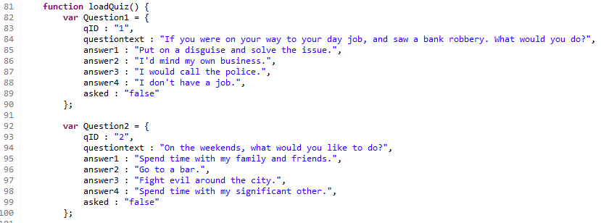
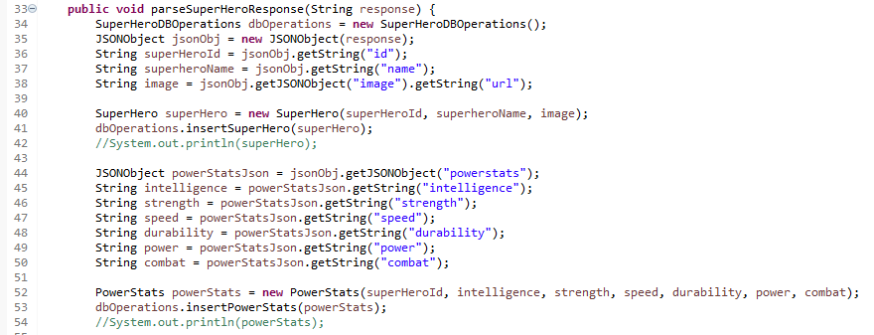
Algorithms
- Shipra
Point based Quiz Question Algorithm
Response from SuperHero API
getting inserted in mySQL database

Slide 12
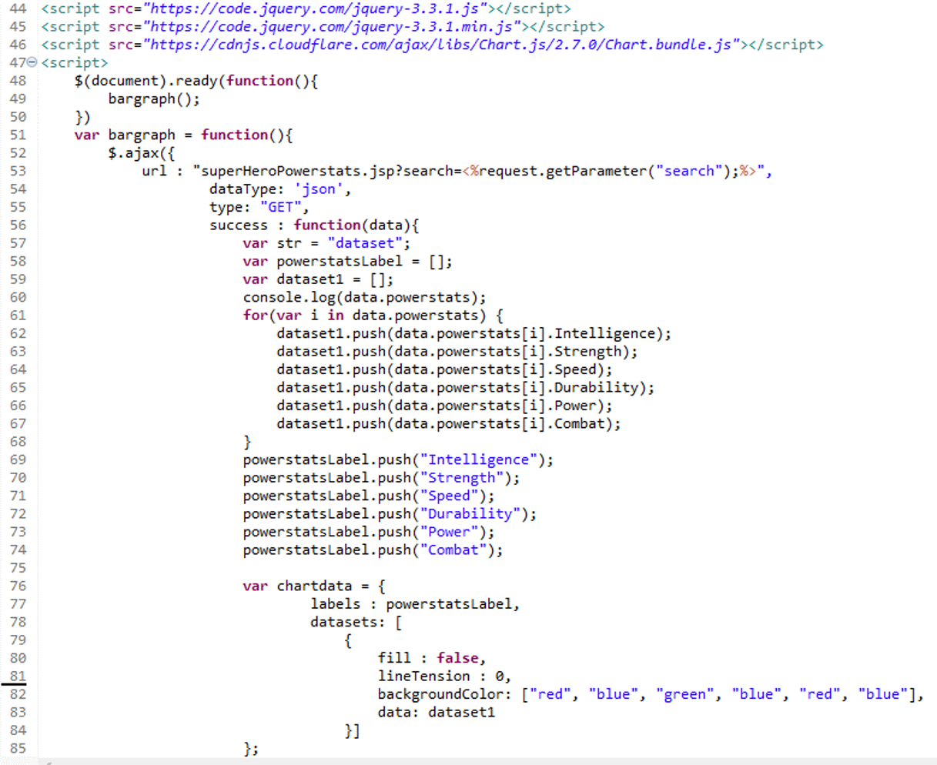
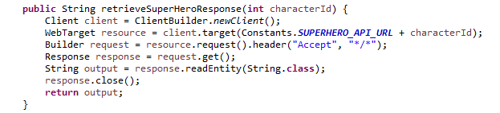
Algorithms
- Shipra
Dynamic Chart Algorithm
for SuperHero PowerStats
Parsing SuperHero API using
Jersey Client to String class

Slide 13







- Riddhi
Tools & Technology
01
02
03
Java/J2EE
mySQL
HTML
04
05
06
CSS
Javascipt
jQuery

Slide 14


- Riddhi
Heroes
Assemble
Project Demo

Slide 15
- Nadia
Testing to esure efficient results for the quiz
Experiments & Results
Display SuperHero Information in one page for End User
No manual intervention was required as data was displayed using database instead of hardcoding

Slide 16
- Nadia
Challenges
Code base transfer between team-mates due to lack of server resources
API having few missing values
Local machine issues for the mySQL

Slide 17
Future Implementation
- Nadia
01
Addition of Favorites
02
Adding Marvel + DC comic book resources
03
Android Application
04
Integration into Firebase database

Slide 18


Thank you !

Slide 19
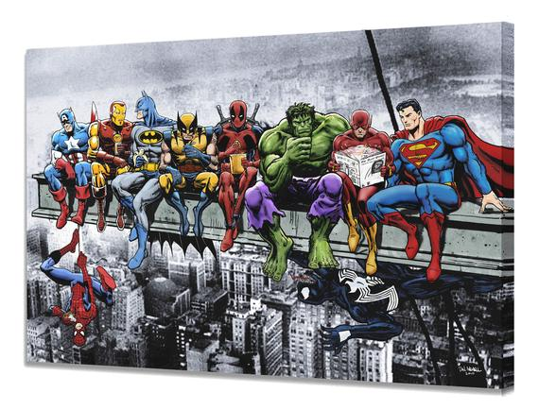
Any Questions?

